Slide 1
Reliability Engineering and Fault Tolerance
COMP6100001 - Software engineering
Session 18
Kenny Jingga, S.Kom., M.T.

Slide 2
Session 18 – Reliability Engineering and Fault Tolerance
Learning objectives
At the end of this session, students will be expected to be able to:
Define software reliability and understand its importance.
Explore reliability models and metrics.
Learn fault tolerance techniques to enhance reliability.
Design software architectures for reliability.
Measure and improve software reliability.
Discover tools and practices for reliability engineering.
Analyze case studies of reliable software systems.

Slide 3
Session 18 – Reliability Engineering and Fault Tolerance
Content outline
Definition and Importance of Software Reliability
Reliability Models and Metrics
Fault Tolerance Techniques: Redundancy, Graceful Degradation, Recovery Mechanisms
Designing for Reliability in Software Architecture
Measuring and Improving Software Reliability
Tools and Practices for Reliability Engineering
Case Studies on Reliable Software Systems

Slide 4
Definition and Importance of Software Reliability
Definition of Software Reliability:
  Software reliability is the probability of failure-free software operation over a specified period under specified conditions.
Importance of Reliability:
  Reliable software minimizes unexpected failures, ensuring that critical systems (e.g., healthcare, finance, transportation) operate safely and consistently.
  Reliability is closely linked to user satisfaction and safety; failures in systems like aircraft control or medical devices can have severe consequences.
Example: Importance of reliability in banking applications, where downtime impacts user trust and financial integrity.

Slide 5
Reliability Models and Metrics
Common Reliability Models
Failure Rate Model: Calculates the probability of failure per unit time.
Mean Time Between Failures (MTBF): Average time between system failures; the higher the MTBF, the more reliable the system.
Mean Time to Repair (MTTR): Average time taken to repair a system after a failure.
A simple measure of reliability is mean-time-between-failure (MTBF), where
MTBF = MTTF + MTTR
The acronyms MTTF and MTTR are mean-time-to-failure and mean-time-to-repair, respectively.

Slide 6
Reliability Models and Metrics
Reliability Metrics
Availability: Ratio of the system uptime to total time, representing the likelihood that the system is operational when needed.
Reliability Growth Models: Models like the Jelinski-Moranda Model assess reliability improvement over time.
Software availability is the probability that a program is operating according to requirements at a given point in time and is defined as
Availability = [MTTF/(MTTF + MTTR)] x 100%
Example: A web application with an MTBF of 200 hours and MTTR of 1 hour has a high reliability, but low MTTR is crucial for mission-critical systems.

Slide 7
Fault Tolerance Techniques
Redundancy
Involves having duplicate systems or components to take over in case of failure.
Example: A load-balanced server setup where traffic is distributed across multiple servers; if one fails, others continue to serve users.

Slide 8
Fault Tolerance Techniques
Graceful Degradation
Ensures that even if a system component fails, the system continues to operate at a reduced capacity.
Example: A video streaming service might reduce video quality temporarily if high-definition servers fail, maintaining the service at a lower quality.

Slide 9
Fault Tolerance Techniques
Recovery Mechanisms
Checkpointing and Rollback: Regularly saves system states to enable rollbacks after failures.
Failover Systems: Automatically switches to a backup system when a failure occurs.
Self-Healing Mechanisms: Systems detect, isolate, and correct errors without human intervention.
Example: In databases, checkpoints allow recovery to the last stable state after a crash, preserving data integrity.

Slide 10
Designing for Reliability in Software Architecture
Principles of Reliability in Architecture
Modularity: Designing the system as independent modules isolates faults.
Redundancy and Replication: Adding extra components or copies of services to prevent complete failure.
Error Detection and Correction: Embedding mechanisms that detect and automatically correct errors.
Failover Architecture: Setting up backup systems that take over instantly in case of failure.

Slide 11
Designing for Reliability in Software Architecture
Reliability Patterns
Circuit Breaker Pattern: Prevents repeated attempts to access a failed service.
Bulkhead Pattern: Isolates components to prevent a failure in one from impacting others.
Event-Driven Architecture: Uses decoupled services to handle high availability and reliability.
Example: A microservices architecture for an e-commerce site uses circuit breakers to isolate failing payment services, allowing other services to continue operating.

Slide 12
Measuring and Improving Software Reliability
Measurement Techniques
Failure Tracking: Recording failure occurrences and analyzing patterns to target improvements.
User Feedback: Tracking customer complaints and reported issues to identify reliability gaps.

Slide 13
Measuring and Improving Software Reliability
Improving Reliability
Refactoring: Improve code to reduce complexity and prevent errors.
Automated Testing: Continuous testing helps detect issues early, especially with regression and performance tests.
Monitoring and Logging: Real-time monitoring and logging help detect and respond to faults quickly.
Example: A company uses monitoring tools like Prometheus and Grafana to track error rates, downtime, and MTTR, focusing improvement efforts on areas with high failure rates.

Slide 14
Tools and Practices for Reliability Engineering
Reliability Engineering Tools
Chaos Engineering Tools: Simulate failures to test system resilience (e.g., Chaos Monkey for Netflix).
Monitoring Tools: Real-time monitoring tools like Prometheus and Grafana track uptime, errors, and performance.
Testing and Automation Tools: Tools like JUnit for unit testing, Selenium for automated UI testing, and load testing tools like JMeter.
Incident Management: PagerDuty and Opsgenie help coordinate response to failures.

Slide 15
Tools and Practices for Reliability Engineering
Game Days
Purposely injecting failures into critical systems in order to:
Identify flaws and “latent defects”
Identify subtle dependencies (which may or may not lead to a flaw/defect)
Prepare a response for a disastrous event
Comes from “resilience engineering” typical in high-risk industries
Practiced by Amazon, Google, Microsoft, Etsy, Facebook, Flickr, etc.

Slide 16
Tools and Practices for Reliability Engineering
Game Days
Large-scale applications are built on and with “unreliable” components
Failure is inevitable (fraction of percent; at Google scale, ~multiple times)
Goals:
  Preemptively trigger the failure, observe, and fix the error
  Script testing previous failures and ensure system remains resilient
  Build the necessary relationships between teams before disaster strikes

Slide 17
Tools and Practices for Reliability Engineering
Example: Amazon GameDay
Full data center destruction (Amazon EC2 region)
No advanced notice of which data center will be taken offline
No notice of when the data center will be taken offline
Only advance notice (months) that a GameDay will be happening
Real failures in the production environment
Discovered latent defect where the monitoring infrastructure responsible for detecting errors and paging employees was located in the zone of the failure!
Not all failures can be actually performed and must be simulated!

Slide 18
Tools and Practices for Reliability Engineering
Other Example: Google
Terminate network in Sao Paulo for testing:
Hidden dependency takes down links in Mexico which would have remained undiscovered without testing
Turn off data center to find that machines won’t come back:
Ran out of DHCP leases (for IP address allocation) when a large number of machines come back online unexpectedly.

Slide 19
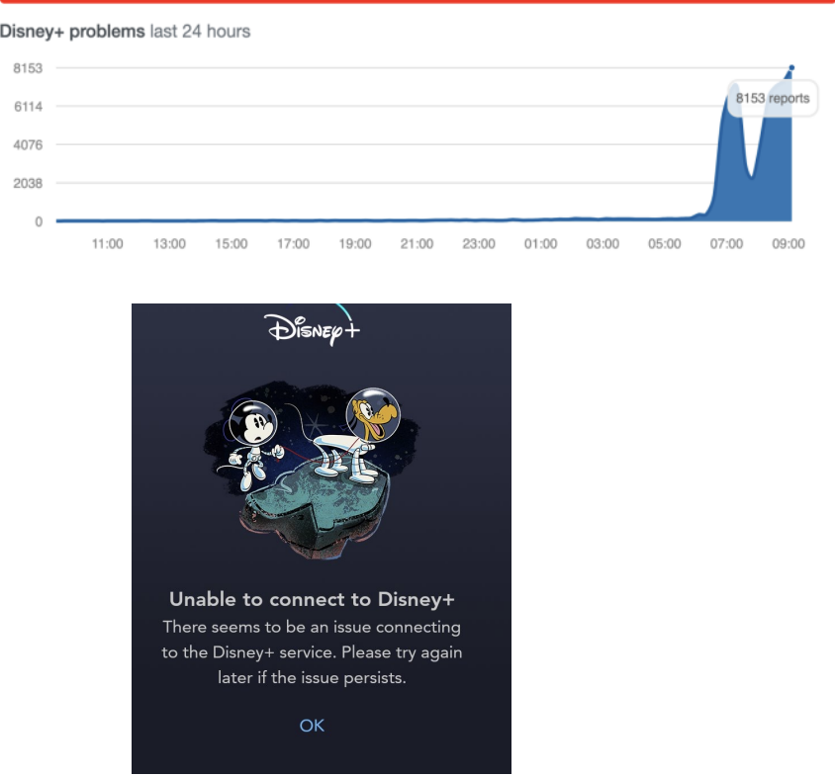
Tools and Practices for Reliability Engineering
Real Issues: Disney+ Launch
Lots of issues reported on launch day.
Disney had planned for a spike in traffic.
  Tested massive concurrent video streaming capability.
BUT: the stress was in paths other than streaming
  User account creation
  Logins and auth
  Browsing old titles

Slide 20
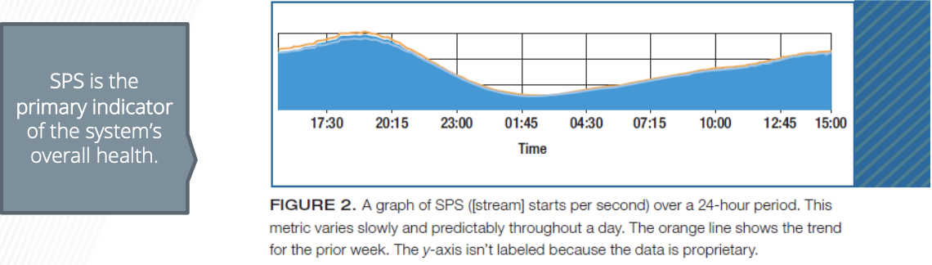
Tools and Practices for Reliability Engineering
Real Issues: Disney+ Launch
Significant deployment in Amazon Web Services in order to remain elastic in times of high and low load (first public, 100% w/o content delivery.)
Pushes code into production and modifies runtime configuration hundreds of times a day
Key metric: availability

Slide 21

Tools and Practices for Reliability Engineering
Chaos Monkey/Simian Army
A Netflix infrastructure testing system.
“Malicious” programs randomly trample on components, network, datacenters, AWS instances…
  Force failure of components to make sure that the system architecture is resilient to unplanned/random outages.
Netflix has open-sourced their chaos monkey code.

Slide 22
Tools and Practices for Reliability Engineering
Real Issues: Disney+ Launch
Significant deployment in Amazon Web Services in order to remain elastic in times of high and low load (first public, 100% w/o content delivery.)
Pushes code into production and modifies runtime configuration hundreds of times a day
Key metric: availability

Slide 23
Tools and Practices for Reliability Engineering
Reliability PRactices
Blameless Postmortems: Analyze failures without assigning blame to identify root causes and improve future reliability.
Continuous Improvement: Regularly review and improve code and architecture based on data from reliability metrics.

Slide 24
Case Studies on Reliable Software Systems
Amazon Web Services (AWS):
  AWS uses distributed architecture with redundancy across data centers, ensuring reliability and uptime for users.
  Techniques: Multi-region failover, automated scaling, and continuous monitoring for high availability.
Netflix:
  Known for its commitment to reliability, Netflix implements chaos engineering to proactively identify and mitigate risks.
  Techniques: Chaos Monkey, redundancy, autoscaling, and extensive monitoring.

Slide 25
References
Pressman, R.S. (2015). Software Engineering : A Practioner's Approach. 8th ed. McGraw-Hill Companies.Inc, Americas, New York. ISBN : 978 1 259 253157.
Risk Management & operational Risk http://www.grafp.com/products/risk-manage.html
Sw maintenance and Reengineering http://www.csse.monash.edu.au/~jonmc/CSE2305/Topics/13.25.SWEng4/html/text.html

